Slide 1
Part 3: Advanced React.js
Clinton.Ayres@gmail.com
Notes:
Part 1: Beginning React
- Before React
- How react works
- Lifecycles
- JSX
Part 2: Intermediate React
- reusable components
- addons
- this.props.children
- form serialization
Part 3: Advanced React
- Focus on Application Building
- React Virtual DOM and optimizations
- Data Flow through Application
- Immutability
[I’ve added Where we came from, and How react works]
Everything changes all the time
Keep up – talking fast. Trying to speed through the beginning slow down for the end
I’m using all the time I have – any questions please come sit with me at lunch or find me and talk or email

Slide 2
Topics
What problems does React solve?
Predecessors: Backbone
Understand basic elements of React
Understand how React renders components
JS Processing VS DOM manipulation
Focus on application building
How Global Application State flows through React
Flux
Immutability
Notes:
Define Component

Slide 3
What you should get out of today:
Why React exists
Clear understanding of how React will process and render your component
Different techniques for managing Global Application State
Principals of Immutability
Performance impacts during Render and Processing phases of React

Slide 4
Thanks!
This talk is essentially a consolidated world-view of many great minds
Please seek out all available videos from:
Rick Hickey
David Nolen
Pete Hunt

Slide 5
Who am I?
Full Stack web developer @ ICE in Atlanta
Work in Java and JavaScript everyday
Develop complex Backbone SPA’s and many internal and client facing React Components
Notes:
Performance is part of my domain

Slide 6
Examples are on GitHub
URL

Slide 7
Benchmarking
Turns out React components are amazingly simple to benchmark
Especially compared to Backbone
Calling React.renderComponent() repeatedly is performant and built-in
Notes:
Define a Benchmark
Top level API provides a callback() once render is completed
And calling this top level API is
In backbone I need to resolve events

Slide 8
Immutability
When you layer high level concepts like immutability you can increase Reacts performance orders of magnitudes.
Immutability will change the way you think about programming
Notes:
We will spend more time today on Immutability than React

Slide 9
Before we begin
Know your past
To tell an accurate story of React we need to travel back in time….

Slide 10
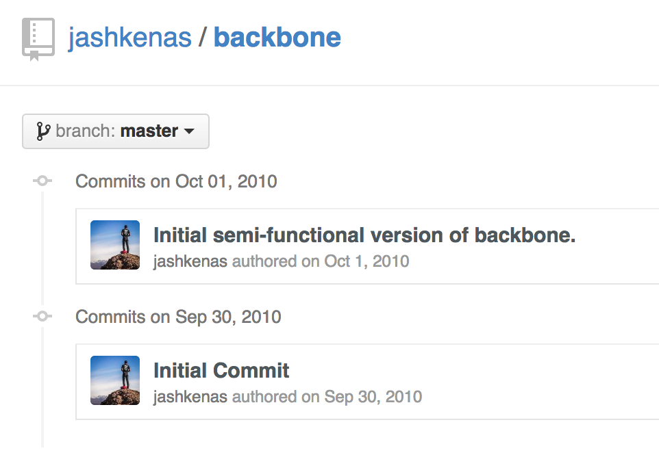
2010
Notes:
Probably not the Backbone we know and love but still an epic day for our field

Slide 11
Backbone’s Paradigm
Event Based MVC
Most frameworks today are of this pattern
A way of structuring a Web Application
Observe Models and Handle Events
Lot’s of events!

Slide 12
Backbone
Data changes have to be manually reflected on the UI through DOM manipulations
Data changes are triggering multiple Views simultaneously
What other code does this model affect?
What is my path through this code given an event?
Data is not defining the state of the UI

Slide 13
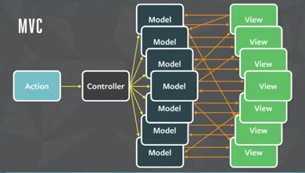
MVC design
http://www.infoq.com/resource/news/2014/05/facebook-mvc-flux/en/resources/flux-react-mvc.png

Slide 14

10,000 cell Table
Notes:
This example will flow throughout the talk
Talk through how you would list to each row and re-render your CellView when data changes

Slide 15
The Data Flow
Render TableView given initial data set
RowViews register event handlers on data set changes
Something mutates data
RowView responds to change by re-rendering cells that changed

Slide 16
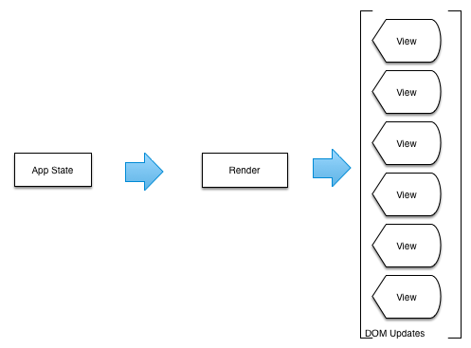
Initial Render

Slide 17
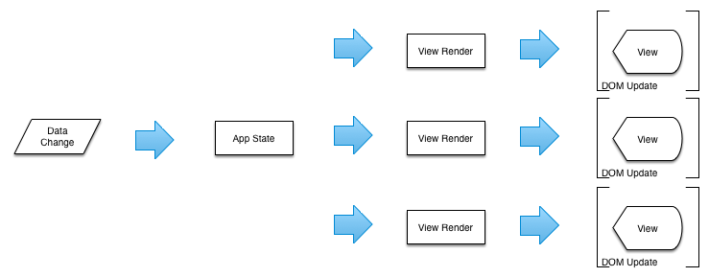
Partial Renders

Slide 18
How do we test initial render?

Slide 19
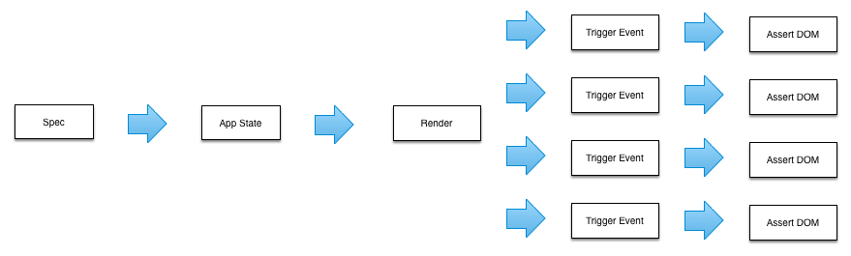
How do we test partial renders?
Notes:
We have to exercise the partial render handlers

Slide 20
Impact
Views are indirectly related to other Views!
What Views depend on this collection?
Who’s listening to what?
What is my code path given an event?
Onboarding new developers is hard!
Notes:
This is where React developers talk about render cycles and how FLUX can help

Slide 21
Simple is maintainable
We would like to re-render the entire screen on a data change
Full page refreshes are too expensive to replay
Notes:
If we can get this we essentially only need to worry about our data and the resulting output
No partial renders
React starts next slide ->

Slide 22
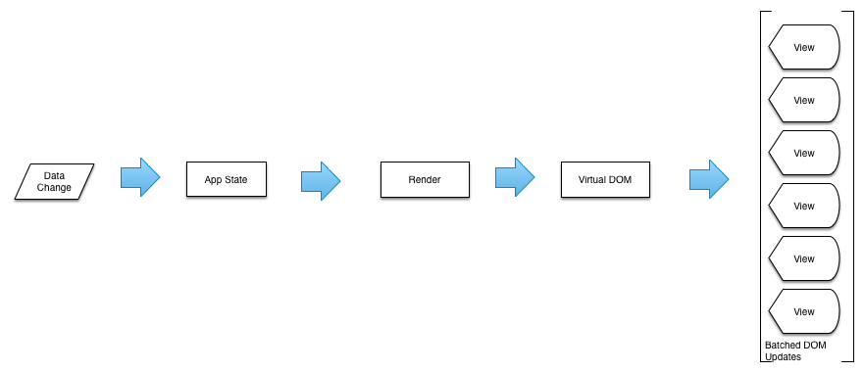
React
Notes:
This is it. No partial rendering. Just change the data, call Render.
Batched DOM updates
- you provide data and you build the entire DOM based on the state of the data
- this is the first lifecycle that that means something
- remember the same data produces the same UI - this is huge

Slide 23
How do we test?
Notes:
Change the data, assert the DOM.
You still need to trigger events to exercise your UI – but the complexity of your code is exercised through data, not events

Slide 24
React
Always re-render framework
Declarative syntax
Virtual DOM
Synthetic Events
JSX

Slide 25
Virtual DOM
Always re-render framework
Virtual DOM produced from each render
Virtual DOM is diffed with Actual DOM
Trees are extremely efficient to diff
Diffs are translated into DOM update statements
DOM updates are batched
Notes:
Talk about diffing trees please.
[Next slide is diagram of this]

Slide 26
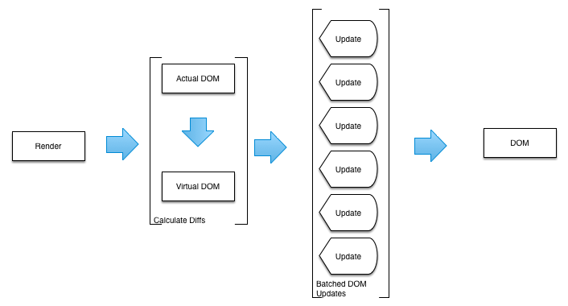
React Virtual DOM
Notes:
[- show an example of shouldComponentUpdate -> false]
- if false the virtual dom is going to be untouched for this component tree and so no actual changes to the DOM will be made
- React is going to give you an oppertunity to render
- with this single method you can control your JavaScript processing times during a React Render
- this method is not called on initial render it's only called on subsequent renders
- this method allows you to tell react to skip processing this Component and all its children
- if you have 100 compoenent and you respond 'false' to 99 of them you've cut your processing time down to a single operation
- this is why Immutability is going to be so important to React
- we can optimize expensive processing with simple referention equality checks
RAF batching strategy – flexible ways to purge the queue
Virtual DOM short cuts after an initial render

Slide 27
Declarative Syntax
Lifecycles are simple and declarative
Think D3
Define all outputs of your component based on the data provided
Idempotent – same data produces same output
Makes testing trivial

Slide 28
JSX
XML in JavaScript
Hierarchical data structures are simple: HTML
No underpowered Templates
Use the full power of JavaScript

Slide 29
Synthetic Events
Common event interface across multiple browsers
Wrapper around browsers native events

Slide 30
Central App State
var appState = {
users: [
{name: 'foo', age: '20'},
{name: 'goo', age: '30'}
],
states: [
{name: 'Georgia'},
{name: 'California'}
]
}
Notes:
Core of React component is application state
Being able to carve, pass, and update this state throughout the component hierarchy proves to be a very deep concern

Slide 31
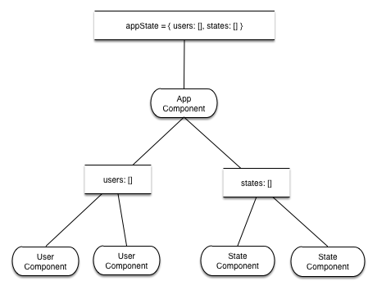
App State Flow
Notes:
A root component receives the app state
Passes discrete data to the child components
Child components can create and modify their State but not the Global State: props
The more discrete your components API the more reusable your components become; looser coupling

Slide 32
Application State in Child Components
Bind to parent provided functions
Tightly coupled API
Cursors
Loosely coupled API
Light weight implementation
Framework dependent
Flux
Loosely coupled API
Heavy weight implementation
Most flexibility
Multiple Controller-Views
Notes:
FLUX you can have multiple Controller-Views or Root Components, your data can begin to Flow down many Roots or really spread out.
The concept is still the same, data is in-sync because we are listening to Stores
UNDO is free!

Slide 33
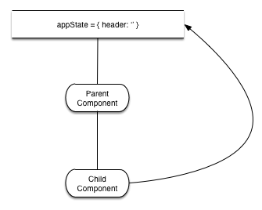
Example Model
Notes:
This is the simplified model we are going to focus on.
See this built with parent binding, cursors, and flux.

Slide 34
Bind: Parent
render: function() {
return (
<div>
<h2>{this.props.header}</h2>
<Child updateHeader={this.updateHeader}
header={this.props.header} />
</div>
);
},
updateHeader: function(event) {
var newHeader = event.currentTarget.value;
this.setProps({
header: newHeader
});
}
Notes:
Simplest to understand
You cannot change props so the owner provides a method to update the properties
Could also be modeled with an event bus

Slide 35
Bind: Child
render: function() {
return (
<input
type='text'
placeholder='Bind: enter a header'
value={this.props.header}
onChange={this.props.updateHeader} />
);
}
Notes:
Simplest to understand
You cannot change props so the owner provides a method to update the properties
Could also be modeled with an event bus

Slide 36
Cursors
Also known as Lens
Way to partition a Global Application State into smaller pieces
Cursors remain in-sync with global app state
Cursors are paths through the app state

Slide 37
Cursor Specs
isEqual = function(a, b) {
return expect(Immutable.is(a, b)).to.be("true”);
};
isNotEqual = function(a, b) {
return expect(Immutable.is(a, b)).to.be("false”);
};
Notes:
Define Spec -> Test

Slide 38
Immutable Spec
it('has basic immutable principals', function() {
var x, y, z;
x = Immutable.fromJS([
{ value: 1 },
{ value: 3 }
]);
y = x.unshift({
value: 0
});
z = y.unshift({
value: 1
});
expect(x.length).to.equal(2);
expect(y.length).to.equal(3);
expect(z.length).to.equal(4);
});
Notes:
Show basic immutable spec first

Slide 39
Cursor Specs
it('is equal to original immutable data', function() {
var cursor, foo, i_foo;
foo = {
pie: 'apple',
portion: 'large'
};
i_foo = Immutable.fromJS(foo);
cursor = i_foo.cursor();
isEqual(i_foo, cursor);
});
Notes:
Show basic immutable spec first

Slide 40
it('can update cursor and perserve Immutable data', function() {
var cursor, foo, i_foo, newData;
foo = {
pie: 'apple',
portion: 'large'
};
i_foo = Immutable.fromJS(foo);
cursor = i_foo.cursor();
newData = cursor.set('pie', 'raspberry');
isEqual(i_foo, cursor);
isNotEqual(cursor, newData);
isEqual(newData.get('pie'), 'raspberry');
});
Notes:
Show basic immutable spec first

Slide 41
it('can allow multiple updates in a single transaction', function() {
var cursor, foo, i_foo, onTransaction, spy;
foo = { pie: 'apple’, portion: 'large’};
onTransaction = function(newData, oldData) {
return cursor = newData.cursor(onTransaction);
};
i_foo = Immutable.fromJS(foo);
cursor = i_foo.cursor(onTransaction);
cursor.update(function(data) {
var updatedData = data.set('pie', 'raspberry');
return updatedData.set('portion', 'small');
});
isNotEqual(i_foo, cursor);
isEqual(cursor.get('pie'), 'raspberry');
isEqual(cursor.get('portion'), 'small');
});
Notes:
Show basic immutable spec first

Slide 42
it('can create sub-cursor and listen to transacitons from main cursor', function() {
var mainCursor, foo, i_foo, onTransaction, subCursor;
foo = { pie: 'apple’, portion: 'large’ };
onTransaction = function(newData, oldData) {
return mainCursor = newData.cursor(onTransaction);
};
i_foo = Immutable.fromJS(foo);
mainCursor = i_foo.cursor(onTransaction);
subCursor = mainCursor.cursor('pie');
subCursor.update(function() {
return 'raspberry';
});
isNotEqual(i_foo, mainCursor);
isEqual(mainCursor.get('pie'), 'raspberry');
});
Notes:
Show basic immutable spec first

Slide 43
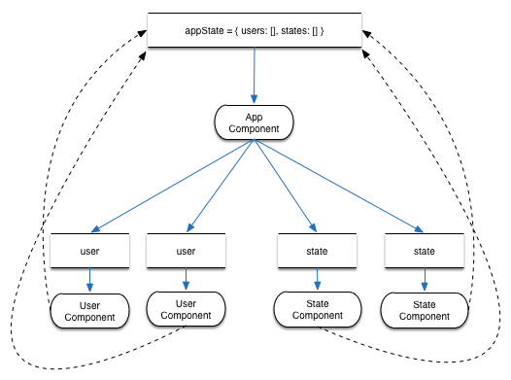
Cursor: Data Flow
Notes:
With a Cursor child components own the data defined by their API
And can manipulate it via sub-cursor
This will cause the entire app to render keeping everything in sync

Slide 44
Cursor: Parent
componentDidMount: function() {
return this.setState({
cursor: this.props.appState.cursor(this.onTransaction)
});
},
onTransaction: function(newData, oldData) {
return this.setState({
cursor: newData.cursor(this.onTransaction)
});
},
render: function() {
return (
<div>
<h2>{this.state.cursor.getIn(['header', 'text'])}</h2>
<Child header={this.state.cursor.get('header')}/>
</div>
);
}

Slide 45
Cursor: Child
render: function() {
return (
<input
type='text'
placeholder='Cursor: enter a header'
value={this.props.header.get('text')}
onChange={this.updateHeader} />
);
},
updateHeader: function(event) {
var newHeader;
newHeader = event.currentTarget.value;
this.props.header.set('text', newHeader);
}

Slide 46

Bind/Cursor Demo

Slide 47
Flux
Design pattern not a framework
Unidirectional Data Flow
Provides a reasonable flow through application code

Slide 48
Flux
Actions
Dispatcher
Stores

Slide 49
Flux Actions
Exposed to Views
Trigger updates on Stores
Routed through dispatcher
Have no Implementation
Describe what you intend to do
Pass payloads to Dispatcher

Slide 50
Flux Dispatcher
Translates an Action into operations on a Store(s)
Manages dependencies between Stores
Emits an event when Action is completed

Slide 51
Flux Store
Application State and Logic
Domain Models
Registered with a Dispatcher
Singleton
Emits Events

Slide 52
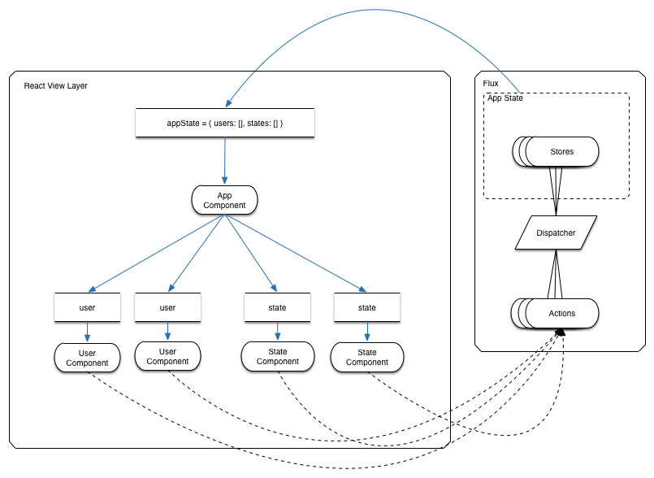
Flux Data Flow

Slide 53
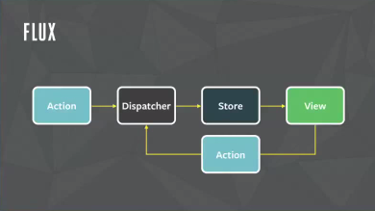
Flux design
http://www.infoq.com/resource/news/2014/05/facebook-mvc-flux/en/resources/flux-react.png

Slide 54
MVC design
http://www.infoq.com/resource/news/2014/05/facebook-mvc-flux/en/resources/flux-react-mvc.png

Slide 55
FLUX: Action
AppDisptcher = require('../dispatcher/AppDispatcher');
ActionTypes = require('../constants/ActionTypes');
module.exports = {
updateHeader: function(newHeader) {
return AppDisptcher.dispatch({
type : ActionTypes.UPDATE_HEADER,
value : newHeader
});
}
};

Slide 56
FLUX: Store
_state = {
header: ''
};
AppStateStore = merge(EventEmitter.prototype, {
emitChange: function() {
return this.emit('change');
},
getAppState: function() {
return _state;
},
setHeader: function(newHeader) {
return _state.header = newHeader;
},
addChangeListener: function(callback) {
return this.on('change', callback);
}
});

Slide 57
FLUX: Store
AppStateStore.dispatchToken = AppDispatcher.register(function(payload) {
switch (payload.type) {
case ActionTypes.UPDATE_HEADER:
AppStateStore.setHeader(payload.value);
return AppStateStore.emitChange();
}
});

Slide 58
getDefaultProps: function() {
return {
appState: AppStateStore.getAppState()
};
},
componentDidMount: function() {
return AppStateStore.addChangeListener((function(_this) {
return function() {
return _this.setProps({
appState: AppStateStore.getAppState()
});
};
})(this));
},
render: function() {
return (
<div>
<h2>{this.props.appState.header}</h2>
<Child header={this.props.appState.header}/>
</div>
);
}
Notes:
Parent

Slide 59
FLUX: Child
render: function() {
return (
<input
type='text'
placeholder='Flux: enter a header'
value={this.props.header}
onChange={this.updateHeader} />
);
},
updateHeader: function(event) {
var newHeader = event.currentTarget.value;
AppStateAction.updateHeader(newHeader);
}

Slide 60
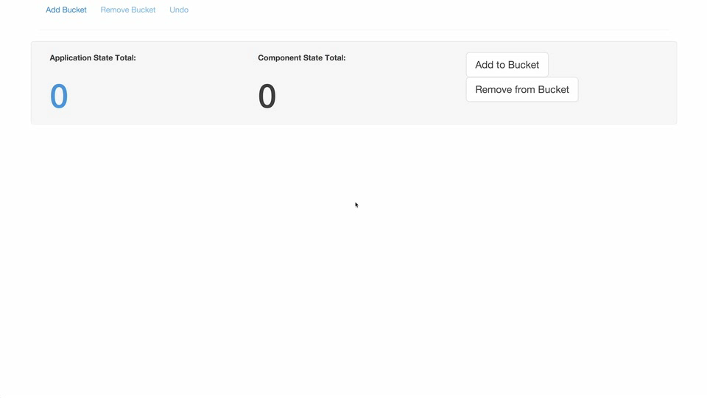

Slide 61
Exploring Tables
Model a 100x100 Table: 10,000 cell table
as a single React Component
as multiple React Components
Can we refactor to get more performance?

Slide 62
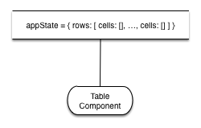
Table as a single React Component
Notes:
This is the render method of a react component named ‘Table’

Slide 63
Table as a single React Component
render: function() {
return (
<table>
{this.props.rows.map(this.renderRow)}
</table>
);
}
Notes:
This is the render method of a react component named ‘Table’

Slide 64
Table as a single React Component
renderRow: function(row, index) {
return (
<tr key= "row-#{index}">
{row.cells.map(this.renderCell)}
</tr>
);
},
Notes:
Still in the react component named ‘Table’

Slide 65
Table as a single React Component
renderCell: function(cell, index) {
return (
<td key= "cell-#{index}">
{cell}
</td>
);
}
});
Notes:
Still in the react component named ‘Table’

Slide 66
Table as a single React Component
suite = new Benchmark.Suite;
suite.add('Table singe component', {
'defer': true,
'fn': function(deferred) {
var row = getRandomInt(numRows),
col = getRandomInt(numColls);
data.rows[row].cells[col] += .001;
React.renderComponent(Table(data),
document.querySelector('#app'),
function() {
return deferred.resolve();
});
}
})

Slide 67
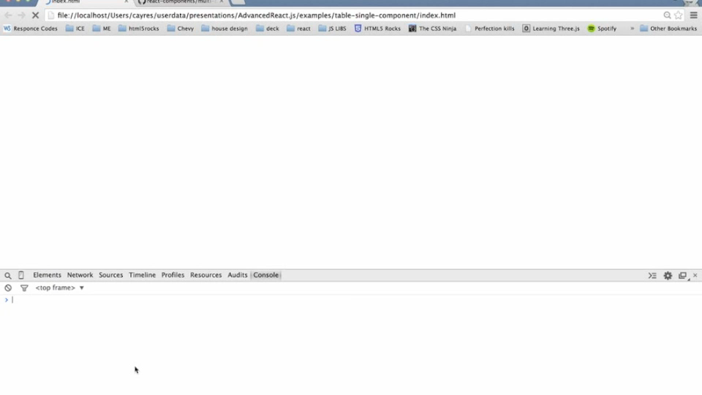

Slide 68
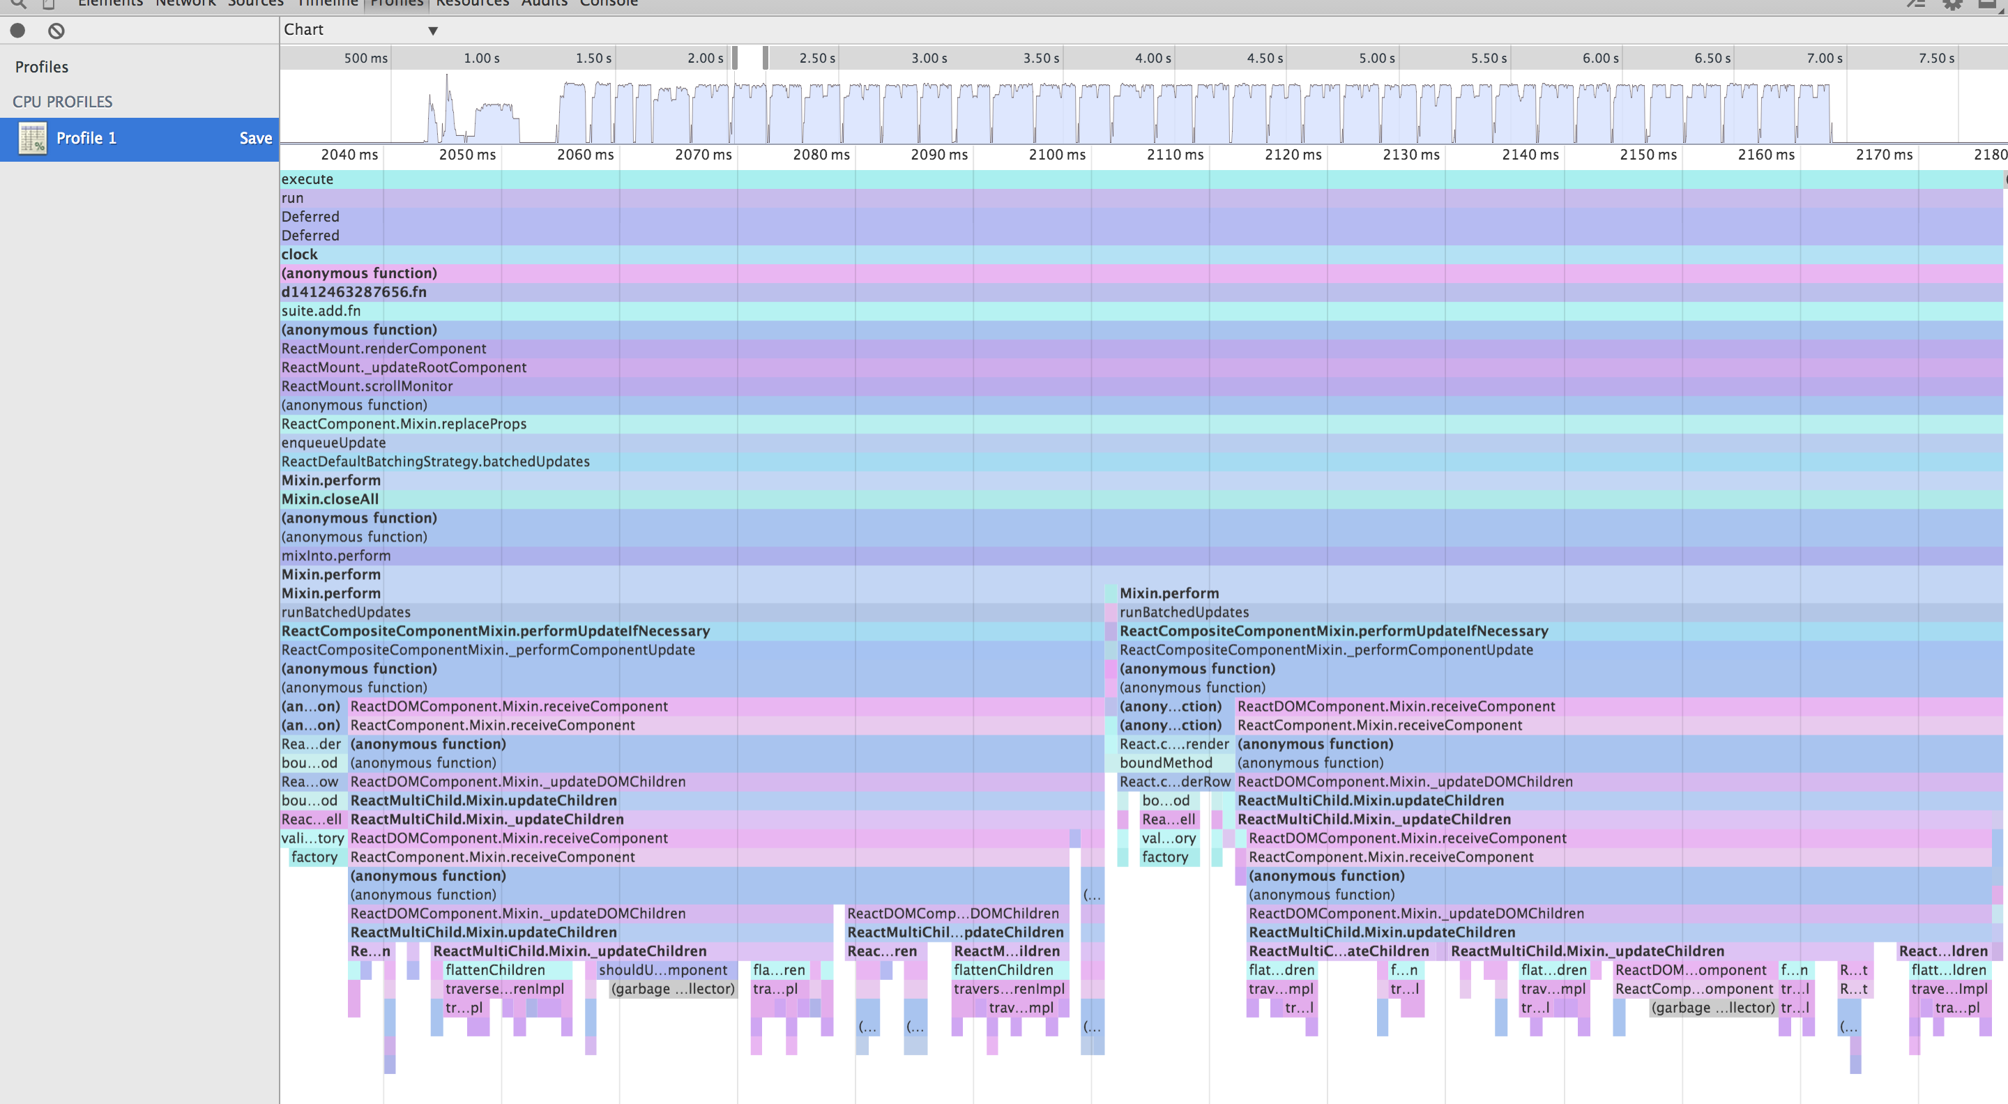
Single Component flame chart

Slide 69
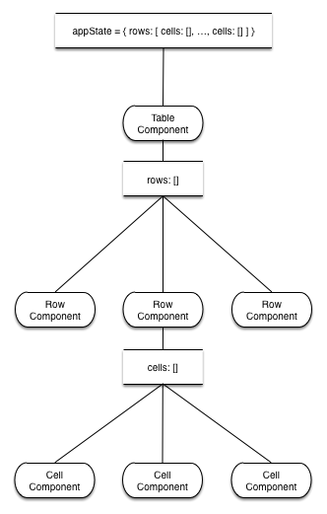
Table as multiple React Components
Notes:
Model

Slide 70
Multiple React Components: Table
render: function() {
return (
<table>
{this.props.rows.map(this.renderRow)}
</table>
);
},
renderRow: function(row, index) {
return (
<Row cells={row.cells} key={'row-'+index} />
);
}
Notes:
Model

Slide 71
Multiple React Components: Row
render: function() {
return (
<tr>
{this.props.cells.map(this.renderCell)}
</tr>
);
},
renderCell: function(cell, index) {
return (
<Cell cell={cell} key={'cell-'+index} />
);
}

Slide 72
Multiple React Components: Cell
render: function() {
return (
<td>
{this.props.cell}
</td>
);
}

Slide 73
Audience Poll
Who will be faster:
Single Component
Multiple Components

Slide 74
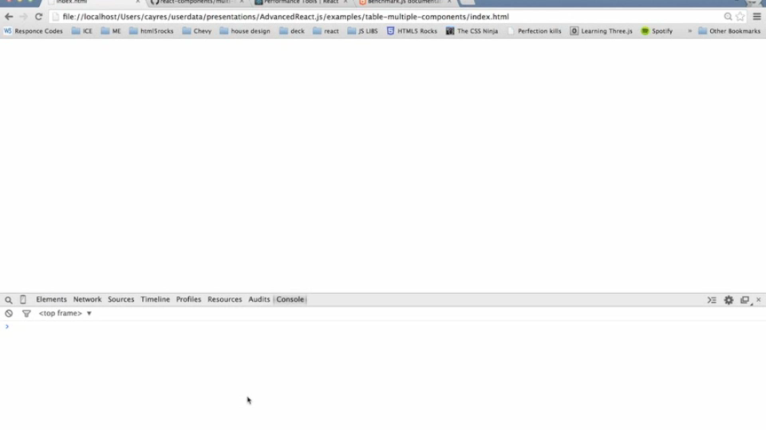

Slide 75
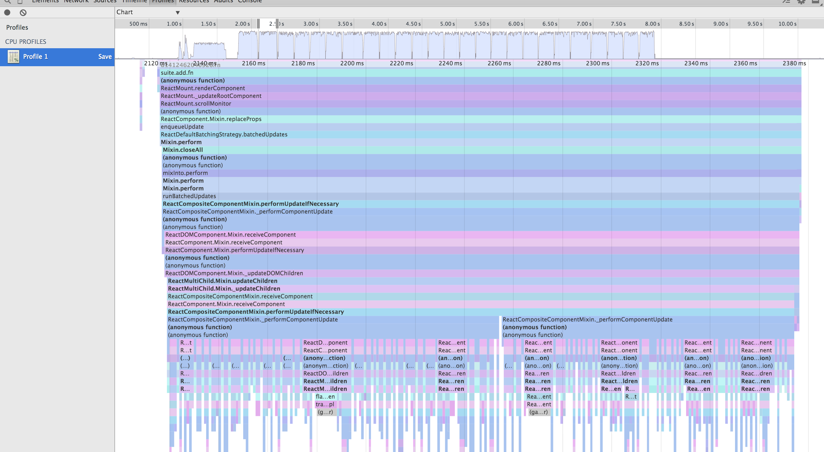
Multiple Component flame chart

Slide 76
We’ll be right back
…you must first think Immutable

Slide 77
Immutability
Persistent Data Structures
Structural Sharing
Immutable-js
Links
Further enlightenment

Slide 78
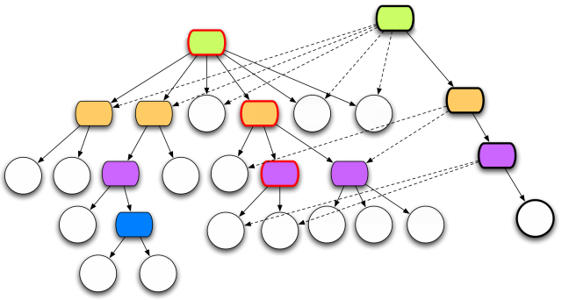
Persistent Data Structures
http://eclipsesource.com/blogs/wp-content/uploads/2009/12/clojure-trees.png
Notes:
Watch David Nolen's talk on [Immutability, interactivity & JavaScript](https://www.youtube.com/watch?v=mS264h8KGwk)

Slide 79
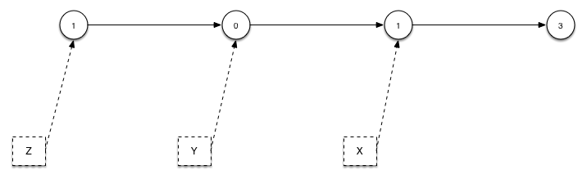
Immutability: Structural Sharing
Notes:
Simplify it to just this we see

Slide 80
Immutable-js Specs
it('has basic immutable principals', function() {
var x, y, z;
x = Immutable.fromJS([
{ value: 1 },
{ value: 3 }
]);
y = x.unshift({
value: 0
});
z = y.unshift({
value: 1
});
expect(x.length).to.equal(2);
expect(y.length).to.equal(3);
expect(z.length).to.equal(4);
});

Slide 81
Immutable-js Specs
it('has shared structure', function() {
var i_x, i_y, i_z, x, y, z;
x = [{value: 1}, {value: 3}];
y = [{value: 0}, {value: 1}, {value: 3}];
z = [{value: 1}, {value: 0}, {value: 1}, {value: 3}];
i_x = Immutable.fromJS(x);
i_y = Immutable.fromJS(y);
i_z = Immutable.fromJS(z);
isEqual(i_x.last(), i_y.last());
isEqual(i_x.last(), i_z.last());
isEqual(i_x.first(), i_y.get(1));
isEqual(i_x.first(), i_z.get(2));
});
Notes:
Powerful, objects that are the same structure have ref equality!

Slide 82
Immutable-js Specs
it('ensures objects are recycled in persistent data', function() {
var bar, foo, i_bar, i_foo;
foo = {
pie: 'apple',
portion: 'large'
};
bar = {
pie: 'apple',
portion: 'large'
};
i_foo = Immutable.fromJS(foo);
i_bar = Immutable.fromJS(bar);
isEqual(i_foo, i_bar);
});

Slide 83
Immutable: App State
Represent data using Immutable-js, Mori, etc
Immutable data structures recycle data instead of copy
object refs remain intact
Servers can replace our data set
React can easily consume immutable data and simply do ref equality checks to determine if it should process
Notes:
Talk about server side json data pushes auto merge with existing data

Slide 84
Table as multiple React Components with Immutability

Slide 85
Multiple React Components with Immutability: Table
render: function() {
return (
<table>
{this.props.rows.map(this.renderRow).toArray()}
</table>
);
},
renderRow: function(row, index) {
return (
<Row cells={row.get('cells')} key={'row-'+index} />
);
}
Notes:
All have mixin Immutable Data Rendering

Slide 86
Multiple React Components with Immutability: Row
render: function() {
return (
<tr>
{this.props.cells.map(this.renderCell).toArray()}
</tr>
);
},
renderCell: function(cell, index) {
return (
<Cell cell={cell} key={'cell-'+index} />
);
}
Notes:
All have mixin Immutable Data Rendering

Slide 87
Multiple React Components with Immutability: Cell
render: function() {
return (
<td>
{this.props.cell}
</td>
);
}
Notes:
All have mixin Immutable Data Rendering

Slide 88
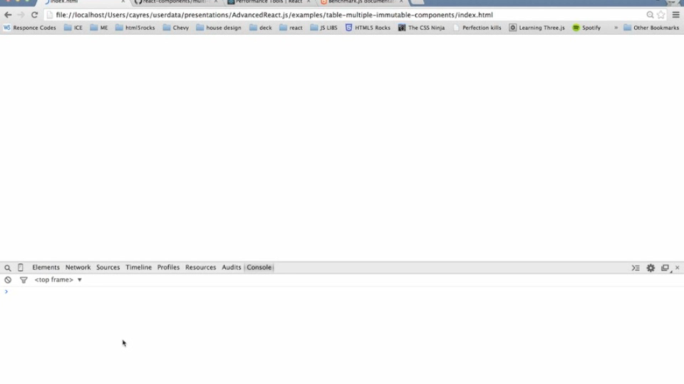

Slide 89
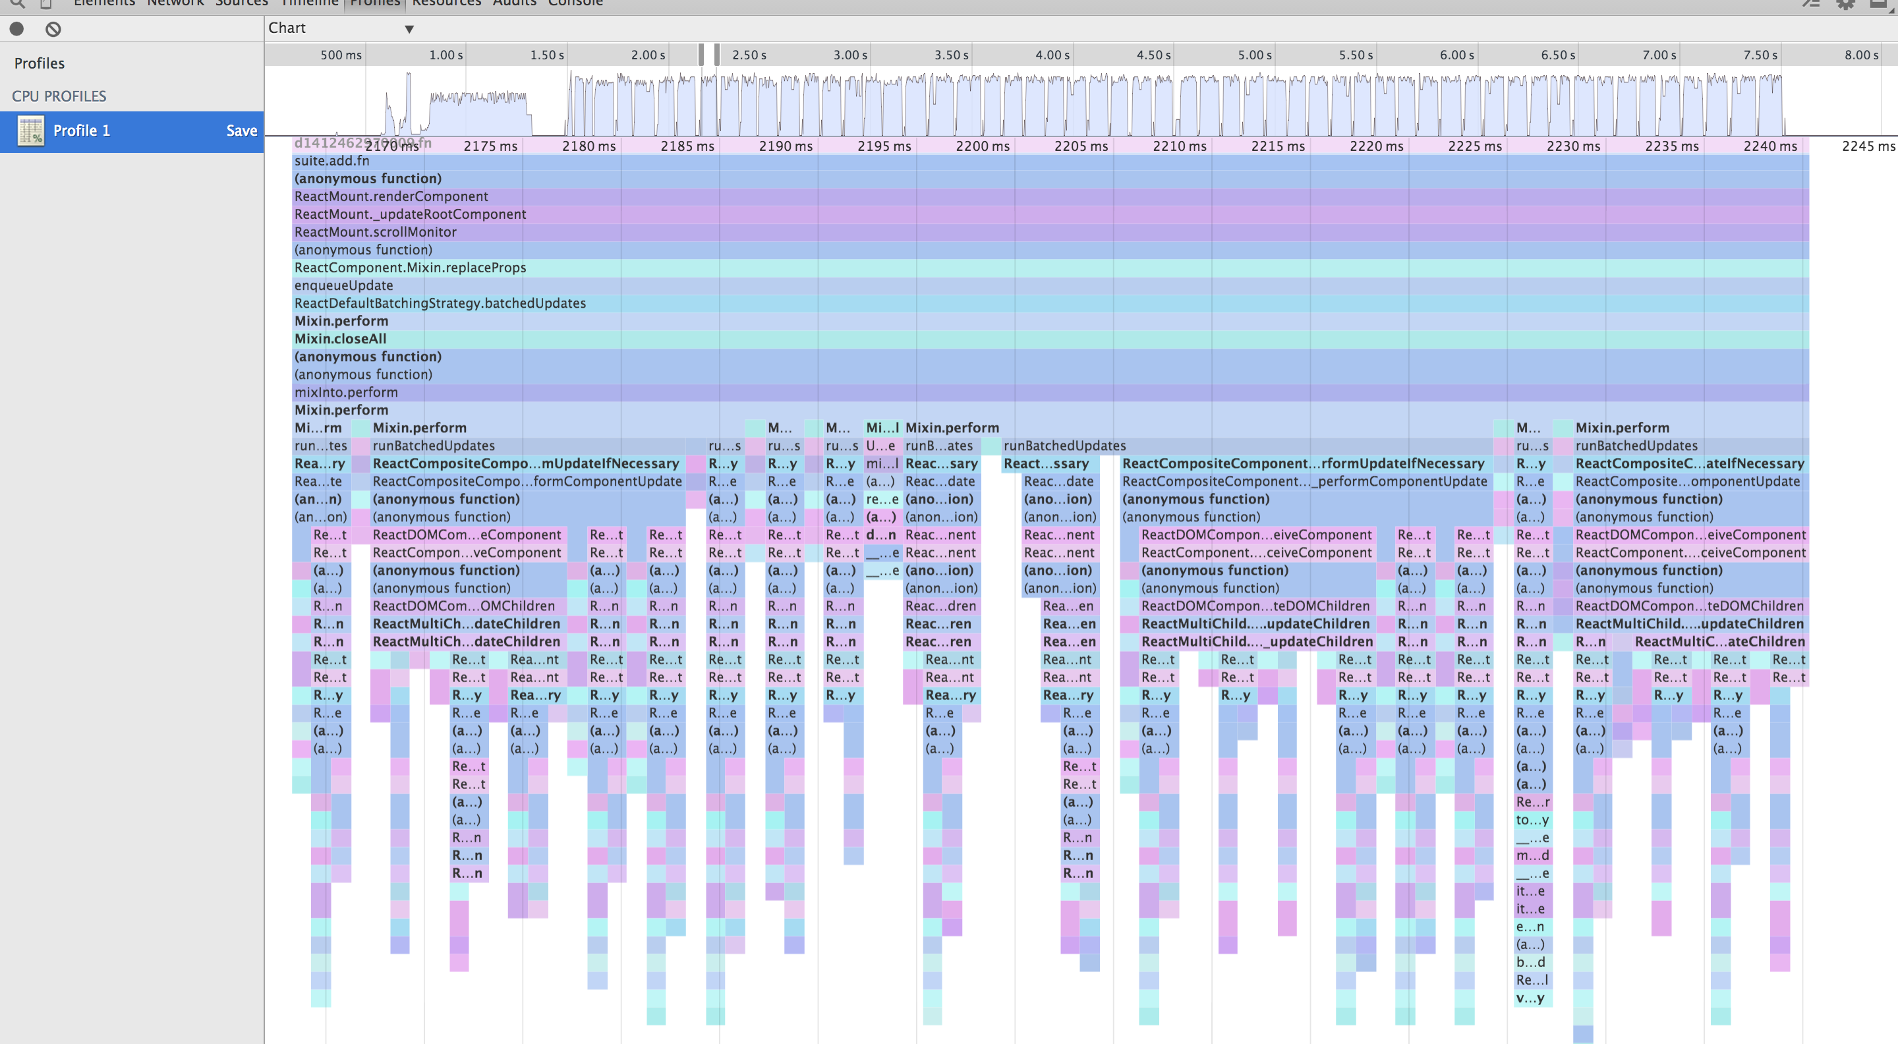
Immutable flame chart

Slide 90
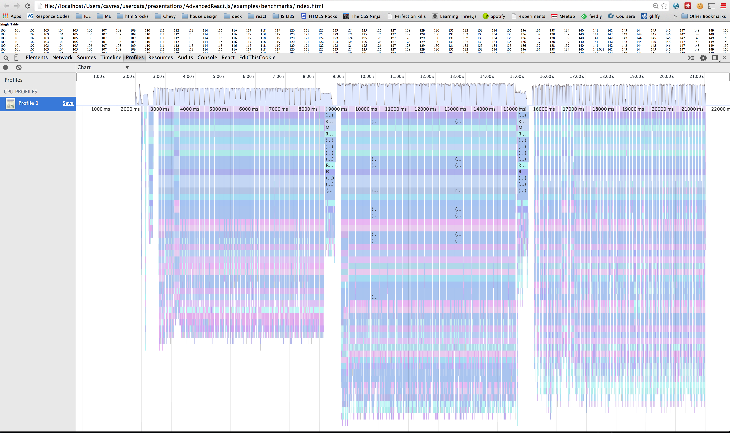
Single, Multiple, Immutable
Notes:
Single, Immutable, Backbone

Slide 91
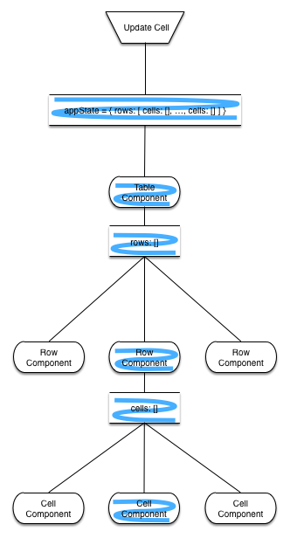
Notes:
Immutable data refs that have changed
Remember our specs – all refs are equal if then contain the same structure

Slide 92
Final Remarks
Immutable App State
React application Building with FLUX
Notes:
If nothing else
1: how the data flows through the app – for non trivial react apps doesn’t provide this for you
2: move to immutable data types the performance gains are clear
Data flow application
App thinking about data
Use immutable data for performance
Immutable data is an amazing tool you need to be using today
Being able – as our specs showcased – to consume server side data and reuse Reacts internal Virtual DOM to efficiently render the DOM is a perf win I think no other framework can match
Transit-js – may in the future be able to increase this speed by emitting immutable friendly data instead of json
- My benchmarking shows that right now Immutable.fromJS() is faster that a Trasit to Immutable-js bridge – this will change in the future
FLUX provides a simple, swappable, scalable application design pattern for React without options – since you can swap it for you design pattern
Manual DOM manipulations, and frameworks/libraries that rely on it are our industry’s past.
No other frame has this future proofing

